Slide 1
Logistic Regression

Slide 2
Motivation
There are many important research topics for which the dependent variable is "limited."
In many situations, the dependent variable is qualitative (categorical)
For example: voting, morbidity or mortality, and participation data is not continuous or distributed normally.
Binary logistic regression is a type of regression analysis where the dependent variable is a dummy variable: coded 0 (did not vote) or 1(did vote)
Estimating a categorical response (dependent variable) for an observation, can be referred to as classifying that observation, since it involves assigning the observation to a category, or class
Often we are more interested in estimating the probabilities of an observation for each category
The most probable category is then chosen as the class for that observation

Slide 3
Examples of Classification Problems
An email is spam or not spam
A biologist collects DNA sequence data for a number of patients with and without a given disease which DNA mutations are causing disease and which are not?
An online banking system manages transactions, storing user’s IP address, past transaction history, and so forth. Is the transaction fraudulent or not?

Slide 4
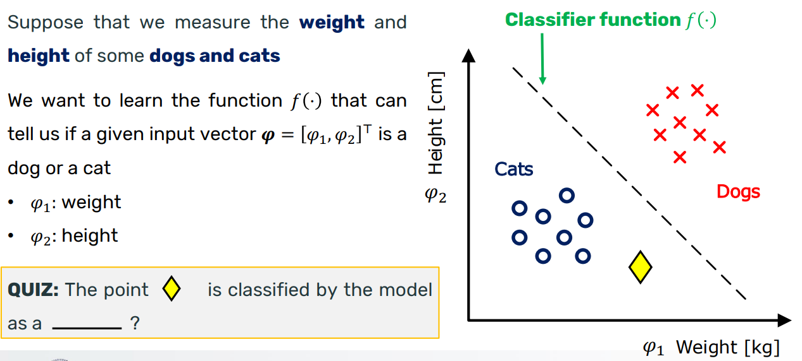
Example: Cat vs Dog Classification

Slide 5
Question???
Consider a company that produces sliding gates. The gates can have four weights 300Kg, 400Kg, 500Kg, 600Kg . We want to detect the weight of the gate. This is a:
A regression problem
A classification problem
Both a regression and a classification problem

Slide 6
Classification and Linear Regression
Linear regression is not suitable:
the predicted value is continuous, not probabilistic
sensitive to imbalance data when using linear regression for classification

Slide 7
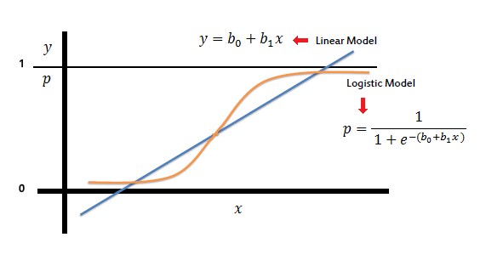
Linear vs Logistic Regression

Slide 8


Logistic Regression Formulation
Estimate the probability that a set of input regressors φ belong to one of the two classes $y∈\left\{0,1\right\}$
The logistic distribution constrains the estimated probabilities to lie between 0 and 1.
$θ^{T}x$ represents the dot product between the parameter vector 𝜃 and the input feature vector 𝑥

Slide 9
This probability can then be used to classify the input 𝑥:
If ℎ𝜃(𝑥)≥0.5, we predict 𝑦=1,
If ℎ𝜃(𝑥)<0.5, we predict 𝑦=0

Slide 10
Cost function for Logistic Regression
Mean Square Error MSE is used as cost function in linear regression
In logistic regression, using the mean square error might give non-convex solution, containing many local minima,
In this case, finding an optimal solution with the gradient descent method is not possible
Logarithmic function is used to represent cost of logistic regression
It is convex for all input values
containing only one minimum
gradient descent algorithm can be used to optimize it

Slide 11

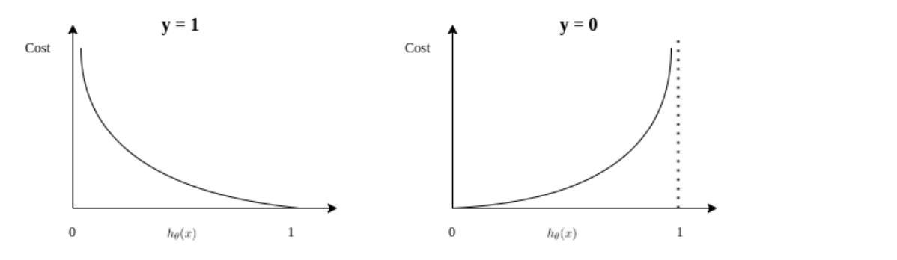
Cost Function

Slide 12


The cost function for a single example (𝑥(𝑖),𝑦(𝑖)) is:
The cost function for m examples:

Slide 13

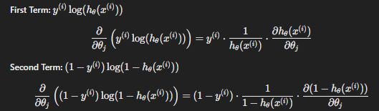
To find the gradient, we compute the derivative of J(θ) with respect to θ j​ :
Using the chain rule, we differentiate each term separately.

Slide 14


After simplifying, we get

Slide 15
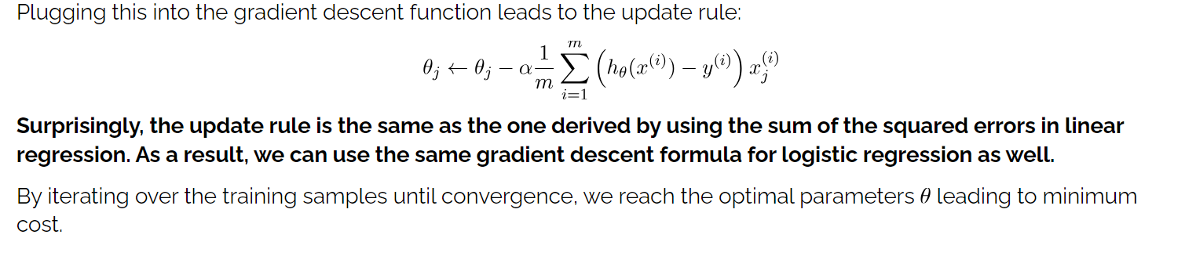

Slide 16
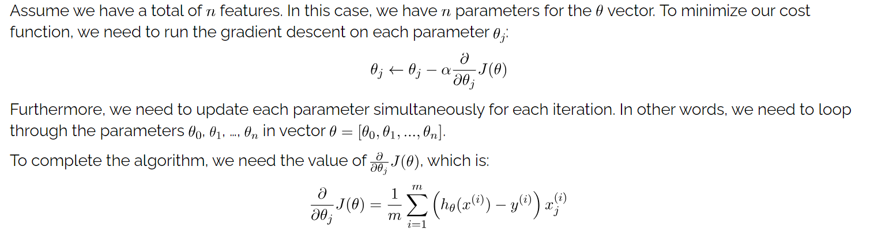

Slide 17


Example

Slide 18
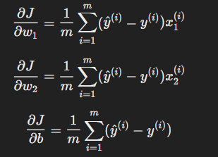
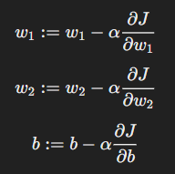
Gradients Computation and Update Parameters

Slide 19
Assume all weights initially are zero
Learning rate is 0.1
After one epoch, what are the new weights?

